Slide 1
Coffee Is Nice
Here are the reasons why

Slide 2
Coffee Coffee Coffee
It warms you up
It wakes you up
It makes you more alert
It smells nice
It has health benefits

Slide 3
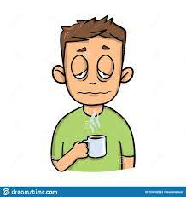
What are the health benefits of coffee?
Coffee contains caffeine which stimulates your nervous system and makes you feel more alert and therefore less fatigued

Slide 4
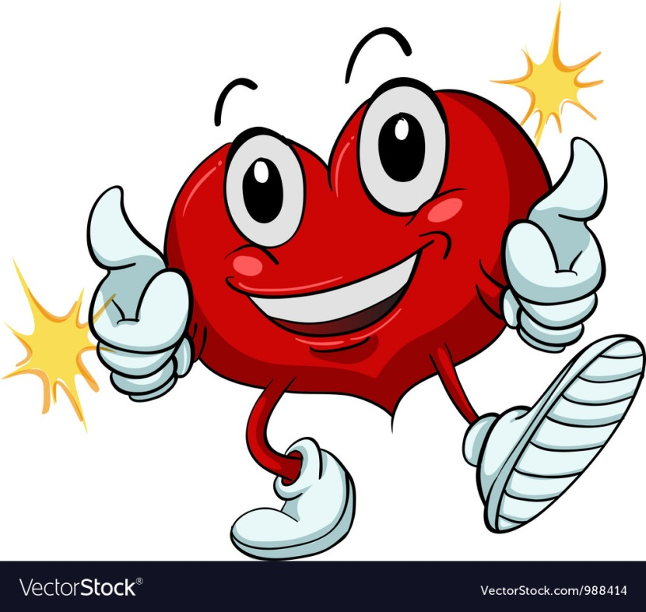
What are the health benefits of coffee?
Some studies show that drinking coffee can benefit your heart health. One study showed a 15% drop in the risk of heart disease

Slide 5

What are the health benefits of coffee?
Coffee can improve your performance and energy levels. Studies have linked coffee to improved performance and speed.

Slide 6
And for balance…..
Coffee can be very expensive, especially take out coffee!
Coffee can have lots of calories if you choose options with full fat milk, sugar and syrups which is bad for you if not in moderation ☹
Too much caffeine can exacerbate anxiety and cause insomnia

Slide 7

My Favourite Coffee
My favourite coffee shop is ….

Slide 8

My Favourite Coffee…..
My favourite drink is …..
A lovely cappuccino ☺

Slide 9
THE END.

